Slide 1
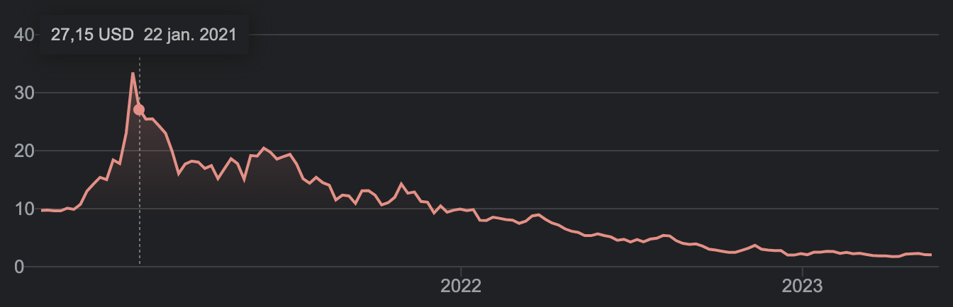

Slide 2



Bitcoin #BTC
-A sentiment analysis of Twitters #BTC, #HODL etc
By Gustav

Slide 3


Agenda
Dataset - Data cleaning - Structuring
Data analysis - Questions - Visualizations
Conclusions

Slide 4
Analysis
Questions: - Sentiment and price (changes) - Tweets versus volume - Followers per view - Locations
Variables
Choice of approach

Slide 5
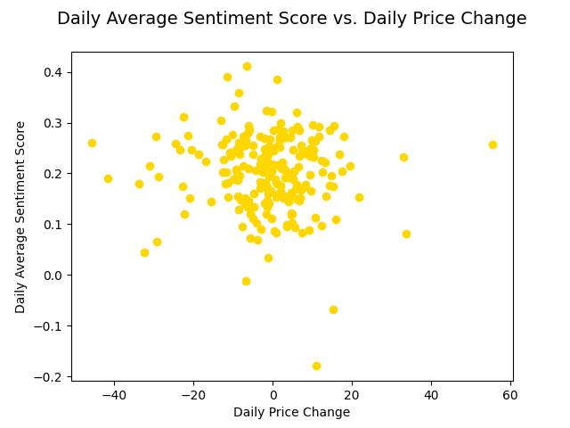

Slide 7
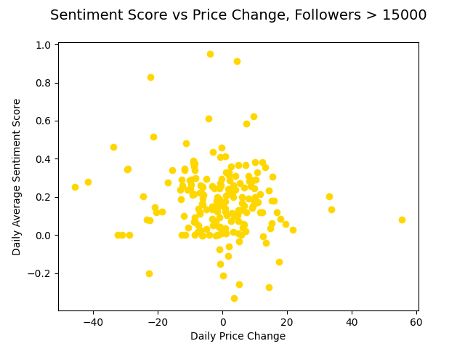


Slide 9
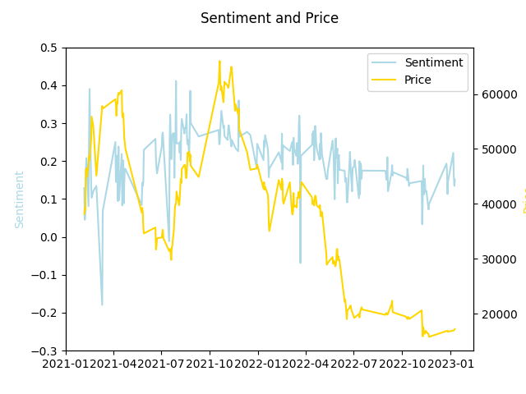

Slide 12
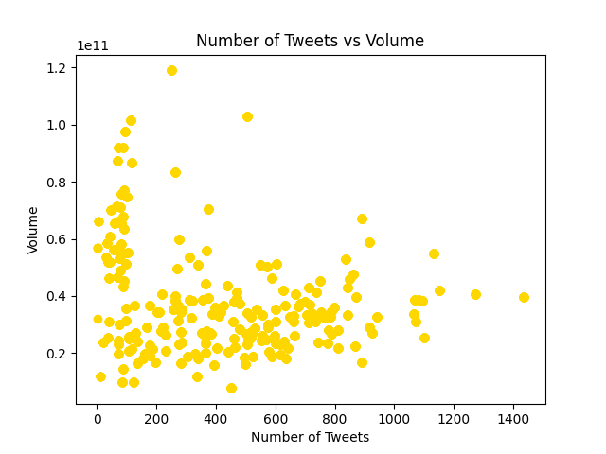

Slide 14
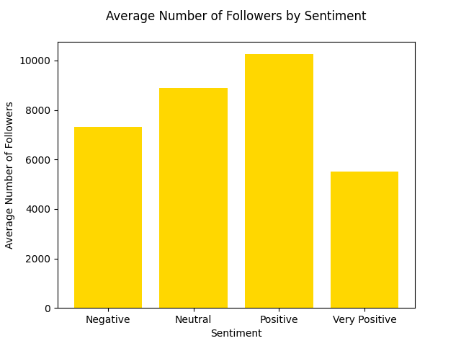

Slide 15
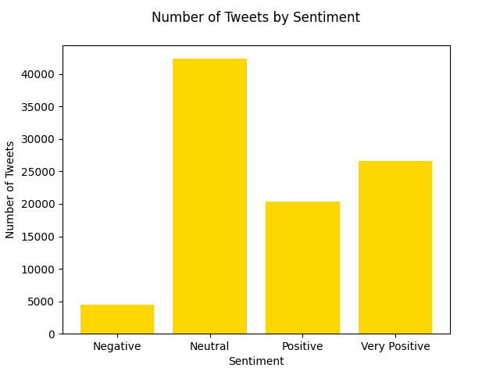

Slide 16
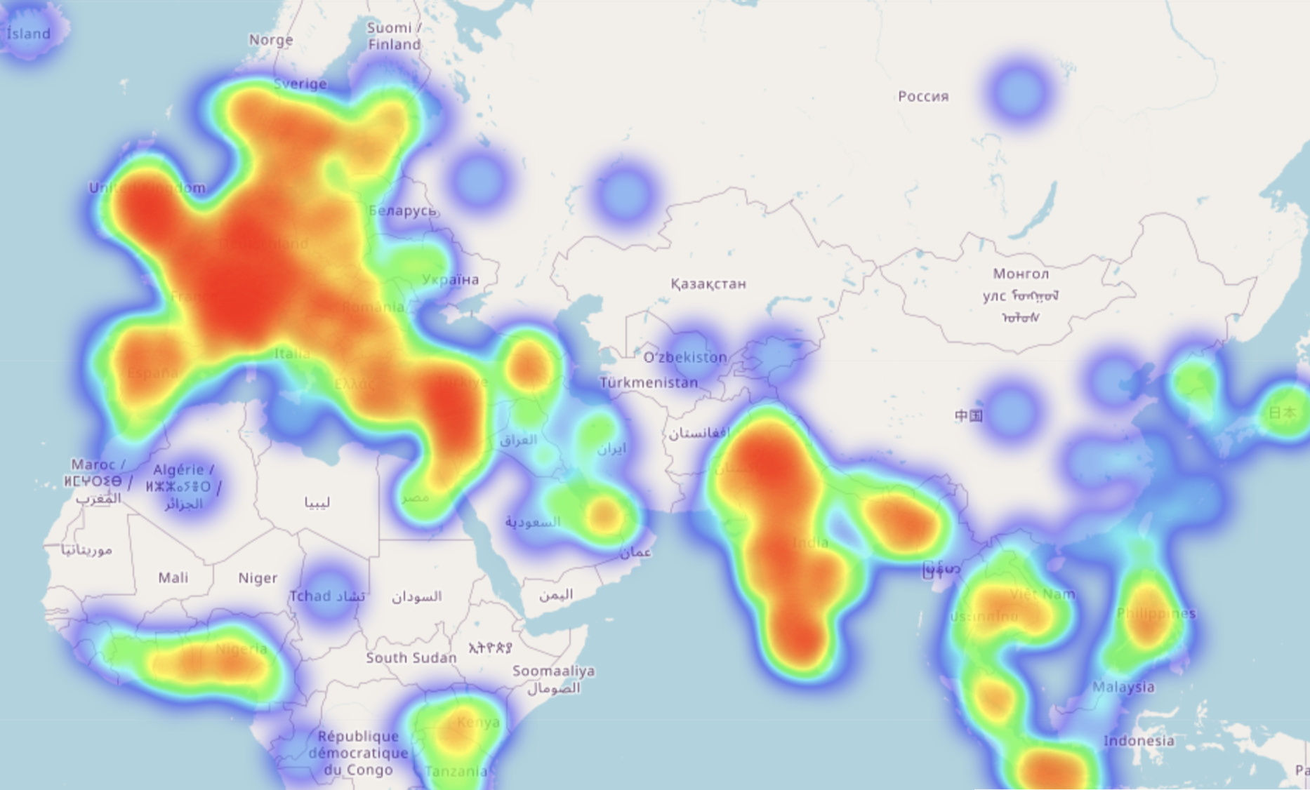
Tweets per area in Europe, Asia and Africa

Slide 17
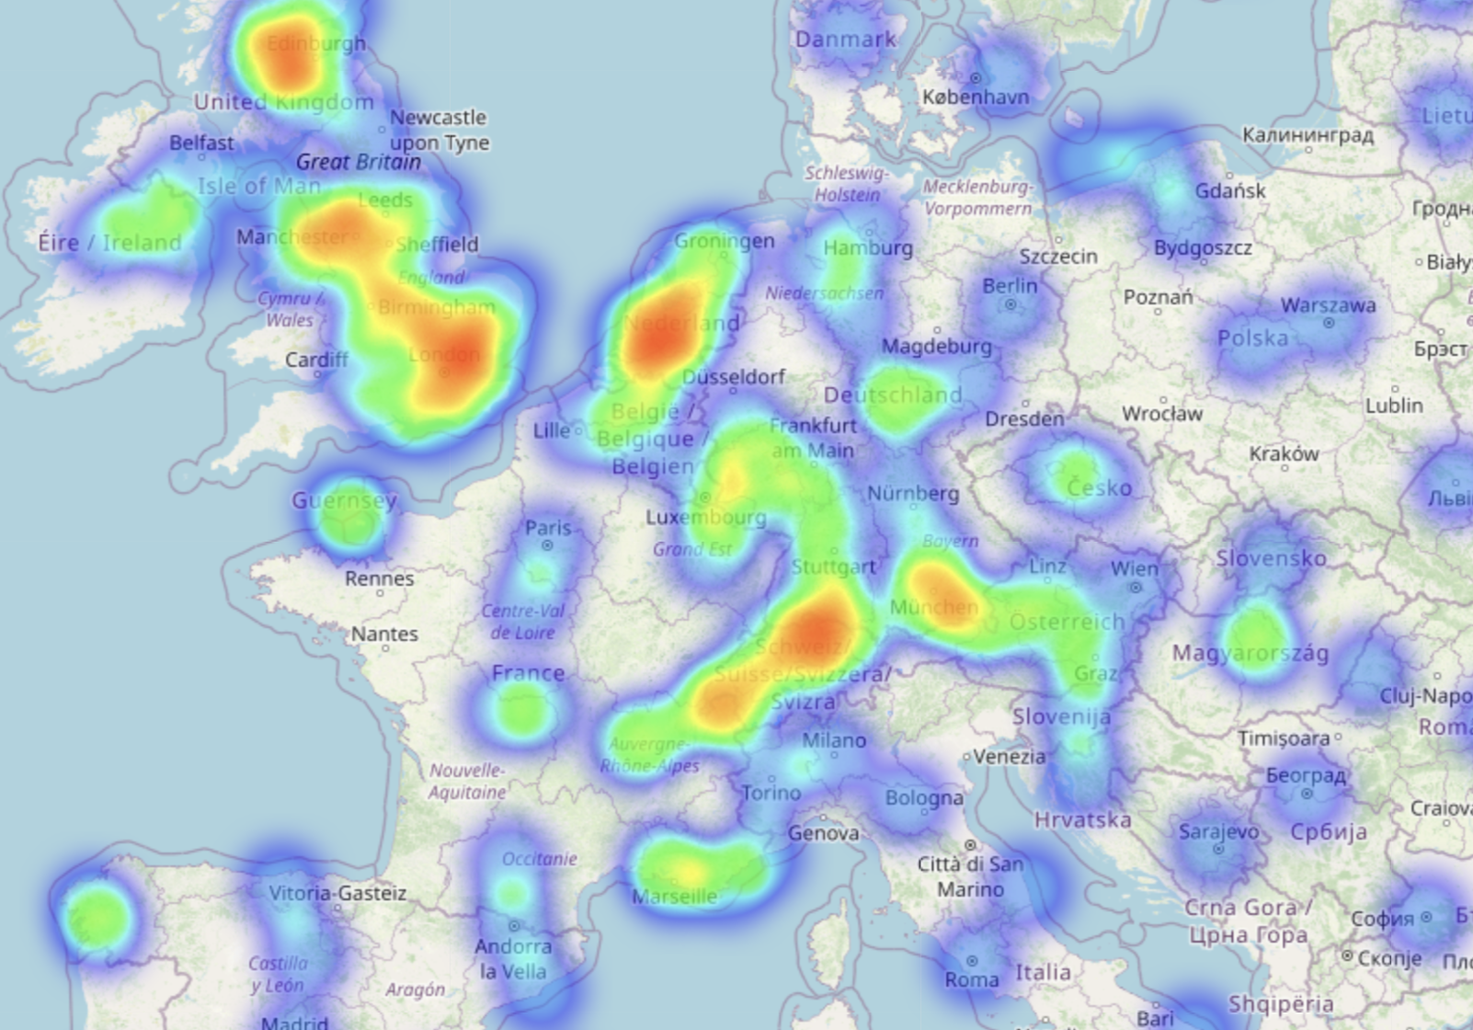
Tweets per area in Europe

Slide 18
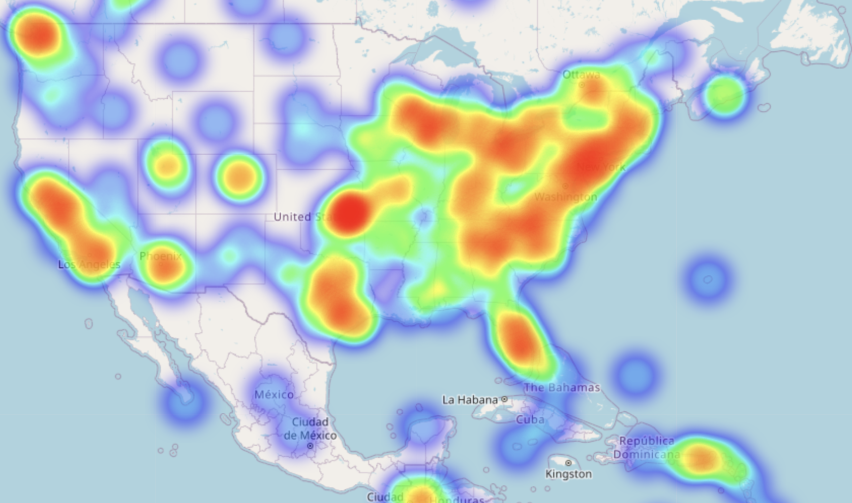
Tweets per area in the US

Slide 19
Conclusions
Generally more discussed in financial centers
Sentiment reacts but remains high
Large volume does not correlate with twitter activity
Twitter is generally positive
Larger accounts => less extreme views

Slide 20
Don’t tweet and trade!

